Slide 1
Enzymes

Slide 2
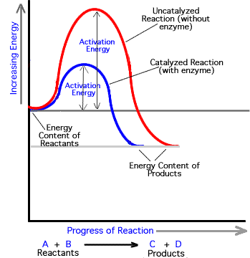
Basic Info
Proteins that speed up the rate of reaction (catalysts)

Slide 3
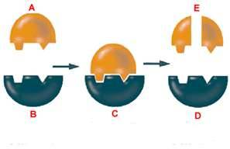
Enzymes
Biological catalysts
Are not used up in a reaction, can be reused if needed
Act on a single substrate or multiple substrates

Slide 4
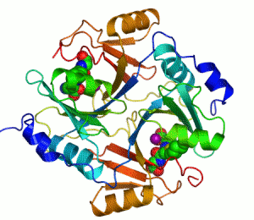
Protein Structure
4 different levels: primary, secondary, tertiary, and quaternary

Slide 5
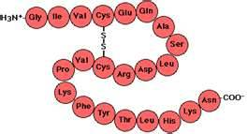
Primary Structure
Basic order of amino acids

Slide 6
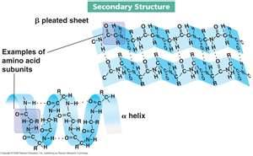
Secondary Structure
Local Interactions between amino acids

Slide 7
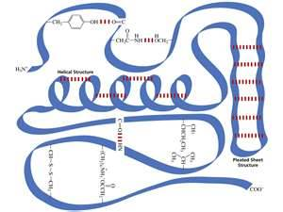
Tertiary Structure
Interactions between distant amino acids

Slide 8
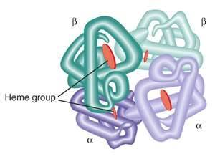
Quaternary Structure
Bonds between multiple proteins

Slide 9
Bonds/Interactions
H-bonds
Van der Waal Forces
Disulfide Bonds
Hydrophobic Interactions
Salt Bridges
Ionic Interactions

Slide 10
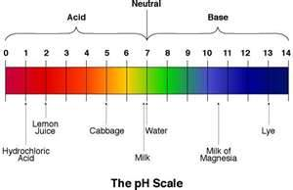
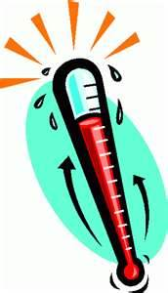
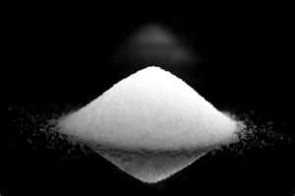
Enzyme Activity
Productivity of enzyme determined on surrounding environment

